Slide 1
MCP: Architecture

Slide 2
Agenda
What is MCP?
MCP's Core Concepts
MCP Architecture Diagram
MCP Communication & Transport Layers
Step-by-Step MCP Workflow
MCP vs. Traditional APIs Comparison

Slide 3
What is MCP?
MCP (Model Context Protocol) is an open standard for connecting AI agents (such as LLM-powered assistants) with external tools, databases, and applications, providing a uniform method for structured interactions and information retrieval
Why MCP? The Challenge of Traditional AI Integrations
Traditional integrations use static APIs, which lack runtime context awareness and dynamic tool discovery.
MCP overcomes rigid endpoints by enabling agentic workflows adaptable on-the-fly.

Slide 4
MCP's Core Concepts
Core elements:
Host: Main LLM application (e.g., IDE, chatbot)
Client: Bridge between Host and Server (1:1 connection)
Server: Offers tools, resources, prompts via schemas
Transport Layer: Handles data exchange.

Slide 5
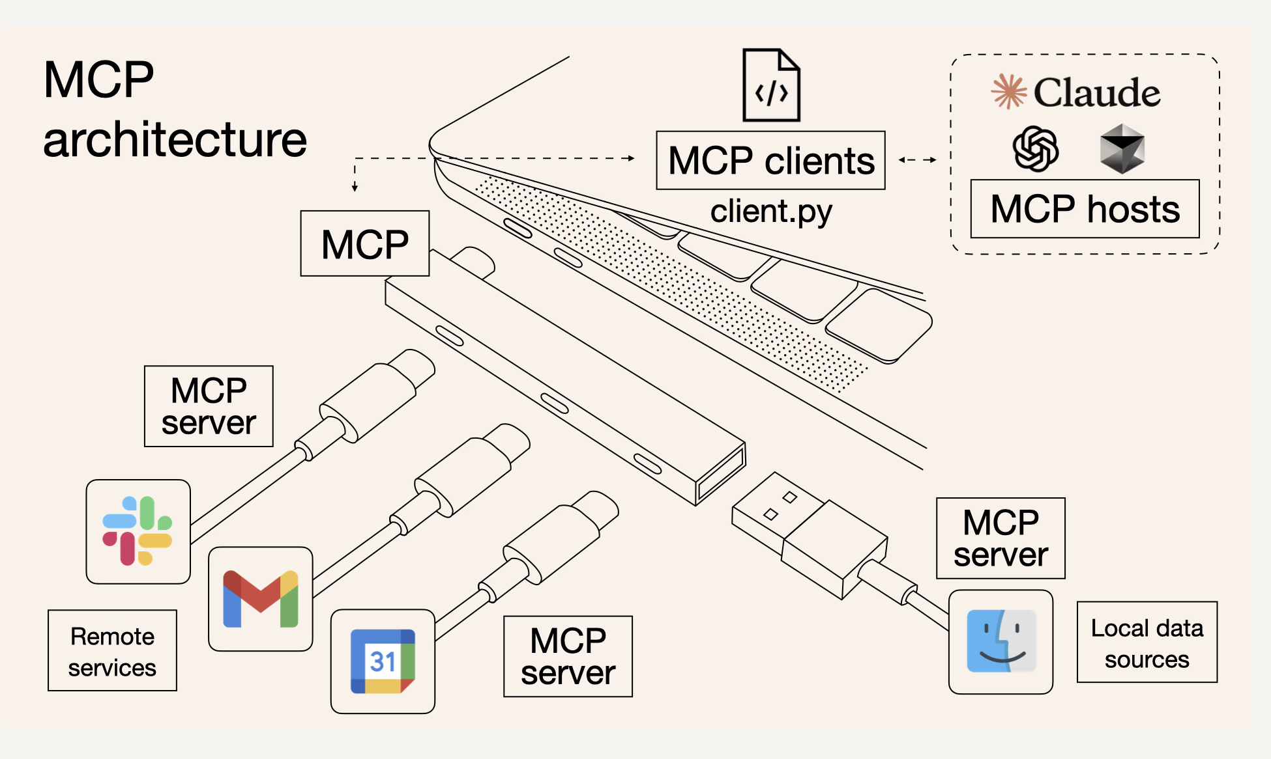
MCP Architecture Diagram

Slide 6
MCP Communication & Transport Layers
Data Layer & Protocol
Communication uses JSON-RPC 2.0 for requests, responses, notifications.
Transport Layer Details
Local (STDIO): Fast, direct communication on same machine.
Remote (SSE/HTTP): Continuous, real-time updates across network; supports authentication (e.g., OAuth)

Slide 7
Step-by-Step MCP Workflow
Host initializes client, client connects to server.
Capability negotiation: What tools/resources are available?
Agent/LLM receives user query.
Tool/resource discovery, execution initiated by client.
Server processes and returns response (can interact with DBs, APIs, etc.)
Results injected into LLM prompt; natural language or structured result sent to user.

Slide 8
MCP vs. Traditional APIs Comparison
Feature | MCP | Traditional APIs
Integration | Dynamic, adaptive, context-aware | Static, rigid
Discovery | Runtime self-describing schemas | Manual coding
Streaming | Yes | Rare
Toolset | Expands based on context | Predefined at design time
Designed for AI models | Yes | No

Slide 9
MCP Hands On– Outcomes
Explain what MCP is and where it fits in the agentic AI stack.
Use core MCP vocabulary: host, client, server, tools, resources, prompts, transport.
Read an MCP architecture diagram and describe the end-to-end request flow.
Run a simple MCP server and call its tools.
Make a small change to an MCP server (e.g., add a new tool).

Slide 10
Recap – Agents & Tools
Agent = policy/brain + memory + tools + goals.
Tools are external actions an agent can take (APIs, DB queries, file access).
MCP standardises how agents talk to tools and data sources.
In this module we focus on MCP servers that expose tools to LLM-based agents.

Slide 11
MCP Lifecycle – High-Level
1. Startup: host launches an MCP client and starts one or more MCP servers.
2. Capability negotiation: client discovers tools/resources/prompts each server provides.
3. User request: user asks a question in the host (IDE, chat interface, etc.).
4. Tool execution: client sends a structured request; server runs underlying business logic.
5. Response: results return to the host and are injected into the LLM’s context.

Slide 12
JSON-RPC in MCP – Simplified Example
Request (conceptual): { "jsonrpc": "2.0", "id": 1, "method": "tools/call", "params": { "name": "get_leave_balance", "arguments": { "employee_id": "E001" } } } Response (conceptual): { "jsonrpc": "2.0", "id": 1, "result": { "content": "E001 has 18 leave days remaining." } }

Slide 13
Architecture → Code: LeaveManager Server
Server: FastMCP('LeaveManager') creates a named MCP server instance.
Tools: get_leave_balance, apply_leave, get_leave_history operate on in-memory leave data.
Resource: greeting://{name} – small reusable context string for greetings.
Prompt: greet_user(name, style) – structured prompt template.
These map architecture concepts to concrete MCP server implementation.

Slide 14
Running the LeaveManager MCP Server
1. Install project dependencies as described in README.md.
2. Run the MCP server (e.g., `python main.py` or via `uv run`).
3. Install/register the server with an MCP client using the `mcp` CLI.
4. From an MCP-compatible host, list tools and call get_leave_balance, apply_leave, etc.
5. Observe how the server responds and how state changes across calls.

Slide 15
Lab 1 – Run & Explore LeaveManager
Goal: become comfortable starting an MCP server and calling tools.
Tasks:
- Start the LeaveManager server locally from main.py.
- From an MCP host/client, call get_leave_balance for a sample employee ID.
- Apply leave for a few dates and re-check the history and balance.
- Discuss how this flow matches the earlier architecture diagram.

Slide 16
Lab 2 – Add a New Tool
Goal: learn how to design and expose a new MCP tool.
Suggested new tool: cancel_leave(employee_id, date).
Behaviour: remove a leave date from history (if present) and adjust the balance.
Return a short human-readable summary of the change.
After implementing, re-run the server and test the tool from the MCP host.

Slide 17
Q&A and Common Pitfalls
Clarify roles of host, client, and server if learners are confused.
Remember to restart the MCP server after code changes.
Choose descriptive tool names and arguments; they form the agent API.
Be explicit about what each tool can and cannot do (security and correctness).

Slide 18
Thank You (Q&A)

